Slide 1





PNB Metlife
Saral Jeevan Bima
Confidential; Not for external circulation

Slide 2
Insurer History & Branding
About Insurer
PNB MetLife is a joint venture where MetLife, NC. Headquarter in USA and Punjab National Bank are the majority stakeholders. PNB MetLife brings together the financial strength of one of the world’s leading life insurance providers, MetLife Inc. and the credibility & reliability of PNB bank, one of the India’s oldest & leading nationalized banks.
Joint Venture | Established in | Headquarter
PNB Bank | 1894 | New Delhi
Metlife | 1868 | New York

Slide 3
Plan Highlights:
1. It is a standard term plan to increase Insurance penetration. 2. Common people can buy – “Specially Low Income group people”. 3. Min SA: 5L & Max SA: 50L allowed.
Claim Settlement Ratio : 99.2 %. Solvency Ratio : 1.87 Death Claim Amount paid in FY 23-24: 407 Cr INR

Slide 4
Eligibility Criteria
Parameter | Minimum |  | Maximum
Age at entry | 18 |  | 65
Age at maturity | 23 |  | 70
Sum Assured | 5.00.000 |  | 50.00.000
Premium Payment Term
 | Single Pay
 | Limited Pay 5,10 and pay till 60 years of age
 | Regular Pay
Premium Payment Frequency | yearly/half yearly/ monthly

Slide 5

Benefit Payout to Nominee:-
Lumpsum: 100% Death Benefit will be payable in lump sum.
Note: Death cover after 45 days of policy issuance except Accidental Death.

Slide 6

Boundary Conditions: Annual Income & Education
Profession | Minimum Annual Income | SA Allowed | Education
Salaried & Self Employed | 2L | 5L to 25L | 10th & Below
Salaried | 3L | Up-to 50L | 12th & Above
Self Employed | 4L | Up-to 50L | 12th & Above

Slide 7
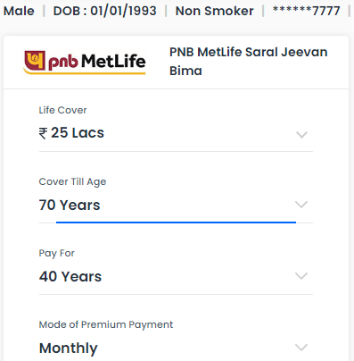
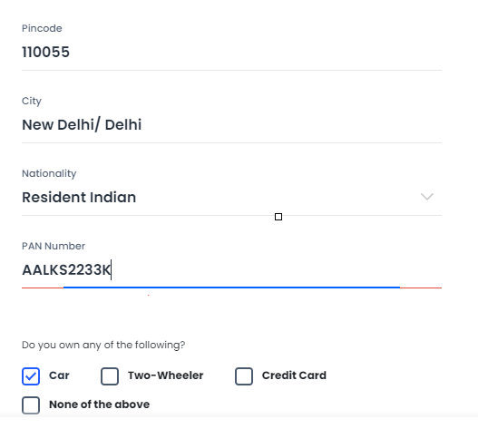
SA Payout Options

Slide 8

Taxation

Slide 9
Terms and Conditions
Free Look Option | 30 days from the day customer receives the policy document/bond
Grace Period | 30 days in case of Y/H/Q frequencies & 15 days in case of M frequencies from the premium due date
Reinstatement/Revival Period | 5 Years from the due date of the first unpaid premium and before the termination date of policy

Slide 10


On-Call Sales Pitch (USP)
PNB is the 2nd largest Government Sector bank in India
One of the biggest Life Insurance Company in India
Least education required
Claim Settlement Ratio: 99.2%
Policy can be offer to HW

Slide 11



